Slide 1
Bricksquad
Devon Hawkins, Ebrima Jobe, Chazz Scott, Morgane’ Cole, Helena Bemberry

Slide 2
Outline
Given Task/Introduction
Iterations
Application Features
Design
Conclusion
Demonstration

Slide 3
Given Task

Slide 4

Required to implement and construct a general purpose Tweet Analyzer
Meaning of general purpose:
a technically sophisticated customer could write their own class that would be linked with the Tweet Analyzer to perform analysis
Or, a non-technical customer could use a “team written” class that accepts regular expressions written by the customer to perform a simple match analysis of tweets
Three components to this project:
general purpose Tweet Analyzer program that uses methods in the Tweet Analyzer class to analyze tweets
(Proof of Concept) a class that will analyze tweets to produce a weather map based on key words
A class that will read a file containing regular expressions to tweets to produce a list of tweets that match

Slide 5
Iterations/Project Plan

Slide 6
Iteration 1:
This iteration is about Requirements and a Project Plan for your project.
Iteration 2:
This should be a complete Product Plan and Requirements Document and a start on the Analysis Document and Design Specification.
Iteration 3:
This is an In Process Review (IPR) to check on the process of your development teams. This should include a complete Analysis Document , a Design Specification that is almost complete, the beginnings of a prototype and Test Specification.
Iteration 4:
This is the beginning of the beta testing cycle. This should include a complete Design Specification, complete Test Specification, and product prototype that are fairly complete
Iteration 5:
This is the final delivery for the software project which includes a PowerPoint presentation about application

Slide 7

Application Features

Slide 8
Why we used these tools?
Python
Research thoroughly that Python has been used successfully in past similar applications
Also, recommended by most twitter application tutorials
Reported very easy to learn
MySQL
Experience from 404 course/team members familiar with tool
Simpler instructions than other databases
Flask
Web-app is easier to access rather than a stand alone application
Web-app can be access on multiple machines and mobile phones

Slide 9
API’s
Twitter’s API (Tweepy)
Twitter’s API allows access (after authentication) to all of twitter’s tweets
Tweepy provides access to the well documented Twitter API.
With this tool it is possible to get any object and or use any method that the official Twitter API offers
Google Maps API
Google Maps is a web mapping service application provided by Google
Powers many map-based services which include: Google Maps website, Google Ride Finder, Google Transit and maps embedded on third-party websites
With Google Maps we have the ability to design and implement a custom map that displays weather conditions on a US map

Slide 10
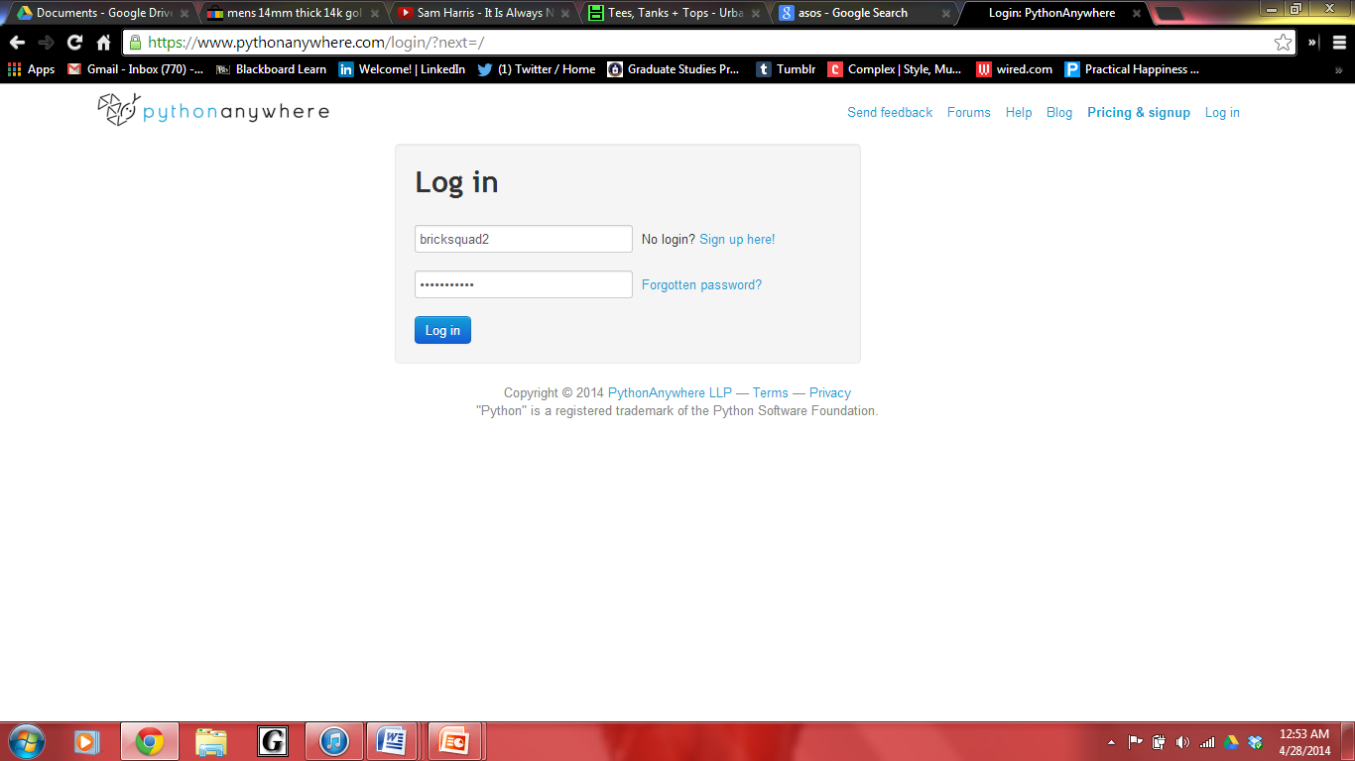
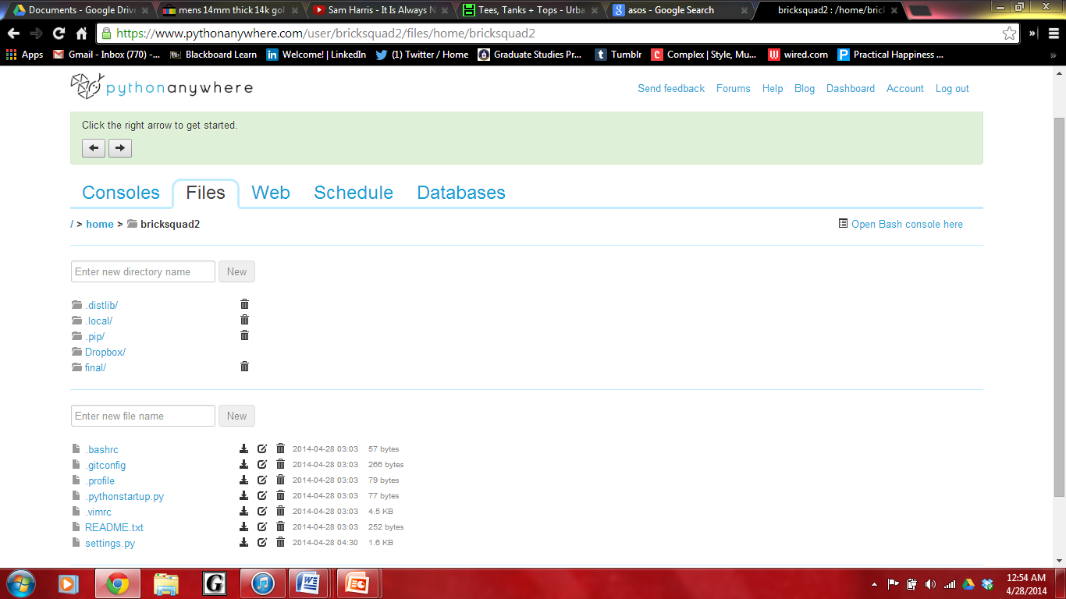
PythonAnywhere/flask Source code edit
This is the login screen when going to
www.pythonnanywhere.com

Slide 11
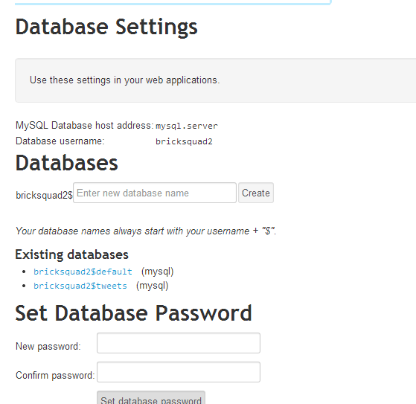
Once login in, the console is available for files and databases

Slide 12
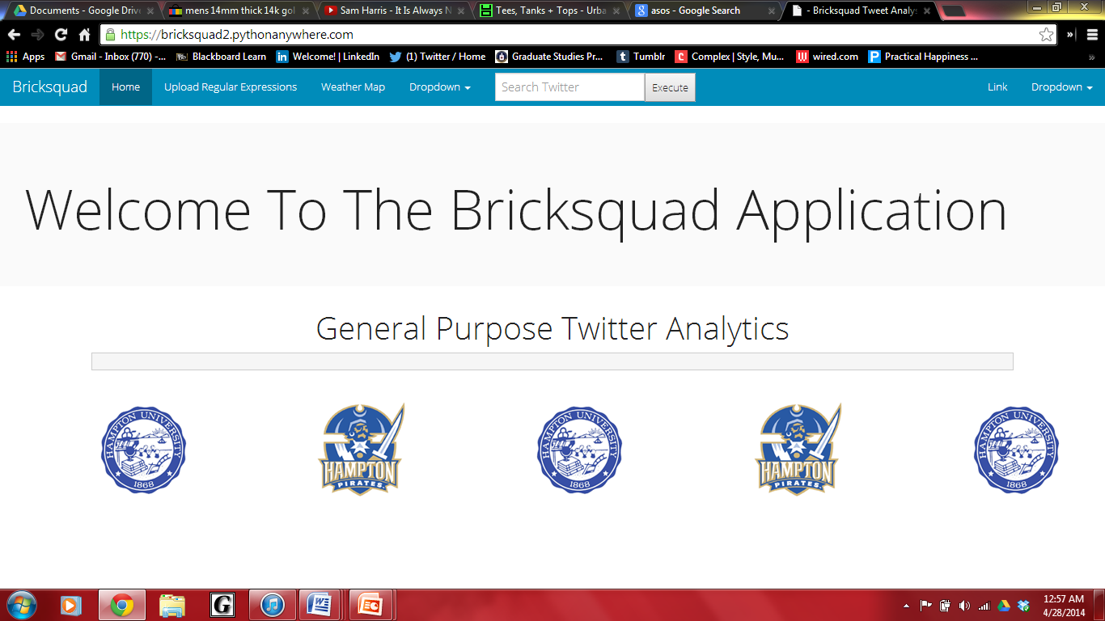

Slide 13
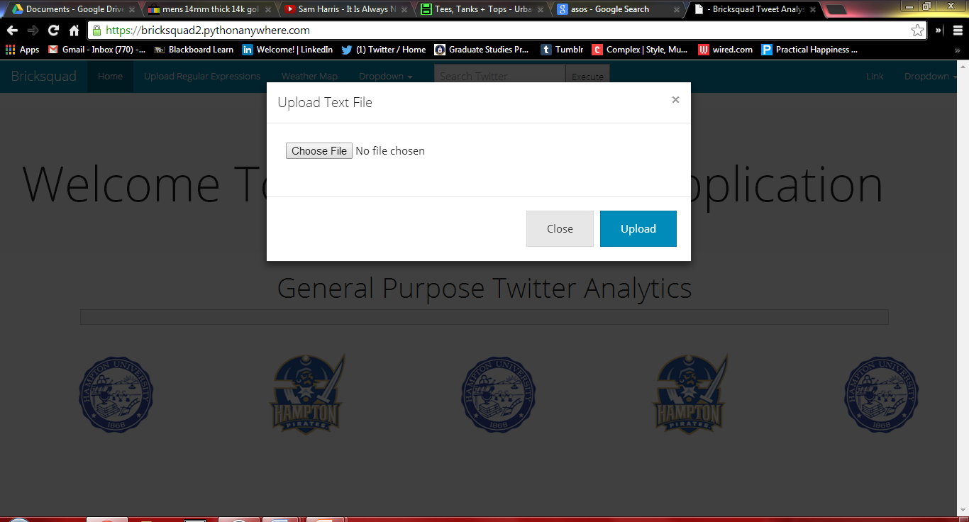
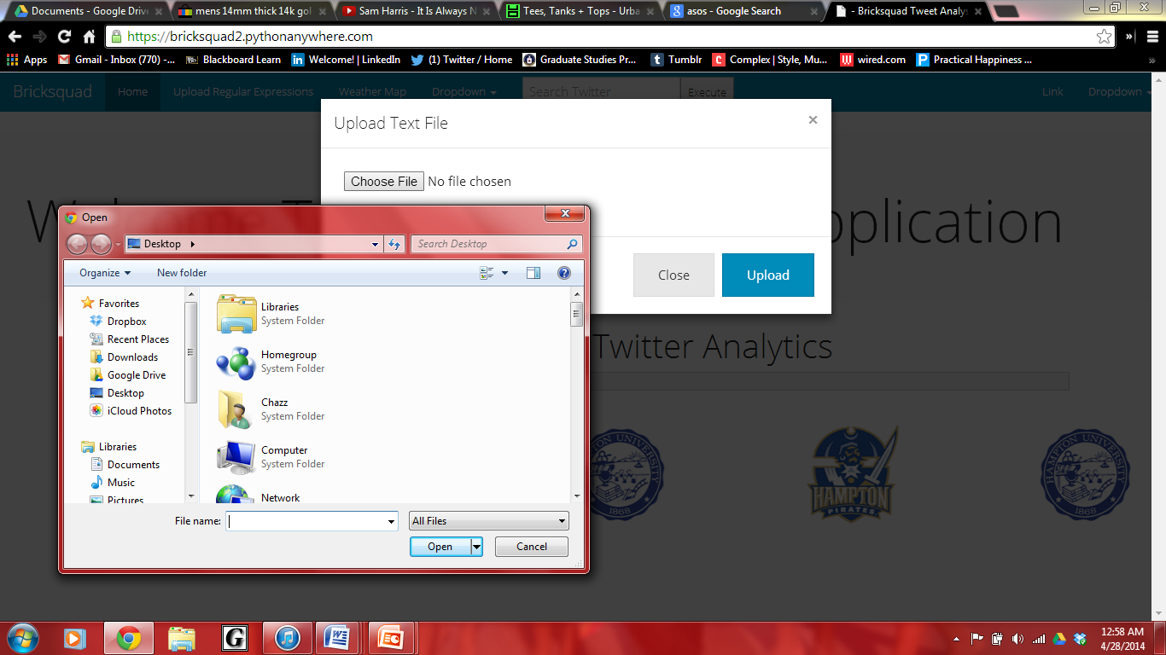
Uploading from a text file

Slide 14
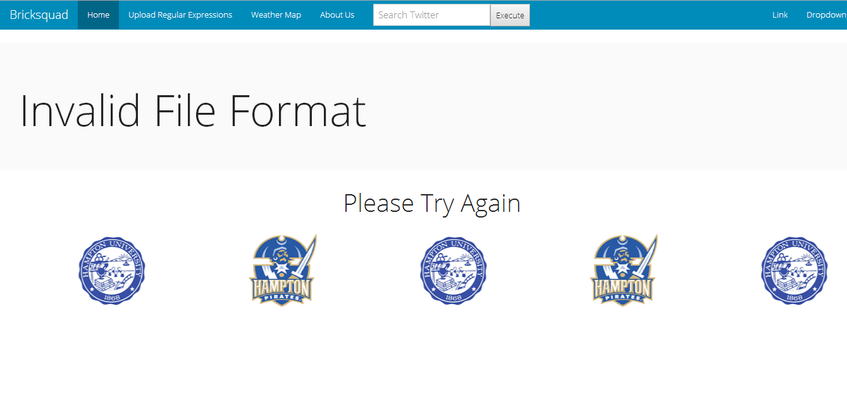
Incorrect File Error
This is the error message a user receives when trying to upload anything other than a .txt file

Slide 15
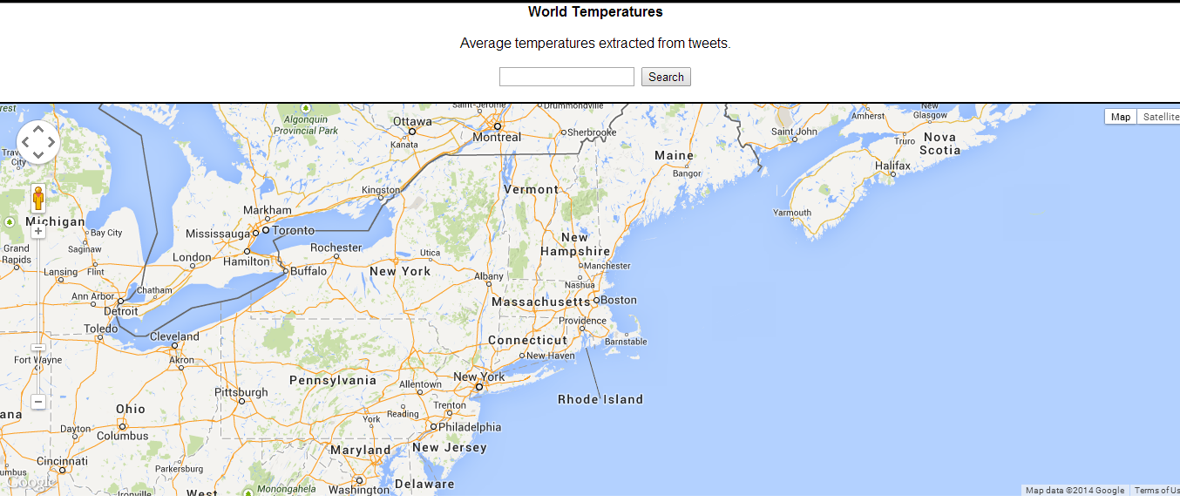
Weather Map

Slide 16
Data Storage
MySQL (Structured Query Language) Database
This open-source relational database management system is used to store our tweets by columns based on search results
Each keyword is stored in a table based on its respective regular expression
The data in the storage can be retrieved for display purposes for our twitter application

Slide 17
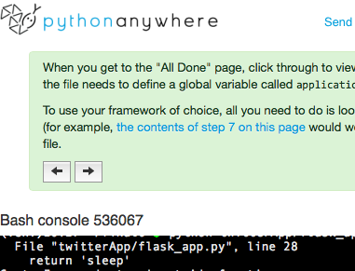
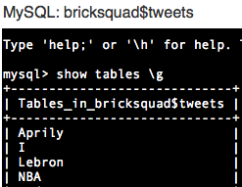
Online Command Prompt
Processed regular expression searches

Slide 18
Demonstration

Slide 19
What went wrong?

Slide 20
Went through 3 different Databases
Apache Hadoop
Was originally our plan due to all the highly praised recommendations via internet and relational database methods
Feature: Big Data
Also, we did not realize we had to set up a server (strict time constraints)
Failed to implement due to complicated instructions and lack of thorough explanations
SQLite – Python’s SQL database that can be incorporated in any Python environment
Easy access, easy retrieval
Failed to implement because couldn’t contain high volume twitter Searches
MySQL
Easy implementation
This database has been successfully used within our application

Slide 21
Continued:
Issue wasn’t raised to stakeholder
1st problem, unsure of how to go about it
Lesson’s learned
Better communication between development team and customer
Unfamiliar implementation with strict deadlines are dangerous
Databases should be top priority

Slide 22
Back end to front end Communication
Back end
Uses MySQL Database retrieves tweets from twitter
Issues commands with collected data based on that specific command
Successfully able to retrieve tweets via command line calls
Front End
Flask App ran on PythonAnywhere bootstrap responsible for producing webpage template, and collecting feedback from user
Successfully able to produce website and multiple view options and page directories

Slide 23
Back End to Front end Communication
Problem – PythonAnywhere failed to support multiple python methods that issued concurrent thread processing
Causing session timeouts when database retrieved from twitter due to never ending process
Lesson’s learned
Stricter requirements for framework search

Slide 24
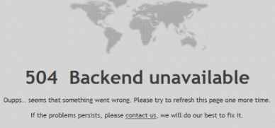
Backend Screenshot of Error

Slide 25


Slide 26
Group Lessons Learned
Analysis and Project Plan
Hypothesized tools to produce application should have had prototypes before full commitment
Development
Multiple sections of prototype code unable to implement due to front end back end error:
Search multiple keywords
Parse Regular expressions from text file
Retrieve weather of U.S through tweets
Updating Google maps API
Selecting data after table in database fills up
Testing
Learn to develop new testing strategies before reaching a complete application
Unit Development Testing was mainly produced through command line
a way to develop more test through the website should have been implemented
Prioritize!

Slide 27
Devon
People management
Effective communication
Ebrima
Working as a team
Sharing ideas
Compromising
Chazz
Working on tasks as a group is a lot more effective than by yourself
Balancing strengths of group members
Communication is key:; make or break the project
Coding should be planned out and well thought out first
Morgane’
Importance of teamwork
Collaborating ideas
Compromising on how to solve issues
Helena
Identifying problems early on
Not just time management; resource management

